Slide 1


The National Institute of Engineering , MYSURU
BACHELOR OF ENGINEERING IN COMPUTER SCIENCE & ENGINEERING
Title - ReqTrace AI: Knowledge Graph-Based Requirement Change Detection and Impact Analysis
Guide by:
ASSISTANT PROFESSOR
DEEPASHREE M

Slide 2
CONTENTS
INTRODUCTION
LITERATURE REVIEW
PROBLEM STATEMENT
EXISTING SYSTEM & PROPOSED SYSTEM
SYSTEM REQUIREMENTS
FUTURE ENHANCEMENTS & CONCLUSION

Slide 3
1.INTRODUCTION
ReqTrace AI is an AI-based software requirements analysis system designed to automate the extraction, organization, and comparison of software requirements from SRS documents. The system uses Natural Language Processing (NLP), Knowledge Graphs, and Generative AI to identify requirements, represent their relationships, detect changes between different versions of requirements, and analyze their potential impact on software modules.
Traditional requirement analysis and change tracking are often performed manually, making the process time-consuming and prone to errors. ReqTrace AI aims to improve requirement traceability, change detection, and impact analysis by providing an integrated platform for managing evolving software requirements.
“ Turning changing software requirements
into clear, connected, and actionable knowledge. ”

Slide 4
3.PROBLEM STATEMENT
Software Requirement Specification (SRS) documents frequently undergo changes during software development. Manually extracting requirements, tracking changes between document versions, and identifying their impact is time-consuming and error-prone.
There is a need for an automated system that can extract requirements, represent their relationships, compare different SRS versions, detect added, deleted, and modified requirements, and support impact analysis.
Manual requirement extraction makes the process slow and error-prone.
Tracking requirement changes across different versions is difficult.
Identifying added, deleted, and modified requirements requires significant manual effort.
Lack of clear traceability makes impact analysis difficult.

Slide 5
4.SYSTEM REQUIREMENTS
Hardware Requirements:-
Minimum 8 GB RAM
Intel Core i5 or equivalent processor
At least 10 GB free storage
Internet connection
Software Requirements:-
Windows 10/11 or Ubuntu 22.04+
Python 3.10+
FastAPI
React.js / Vite
Node.js & npm
Neo4j for Knowledge Graph
Git/GitHub

Slide 6
4.SYSTEM REQUIREMENTS
AI/Technology Requirements:-
NLP for requirement extraction
Knowledge Graph for requirement relationships
Generative AI/LLM for intelligent analysis
REST API for frontend–backend communication

Slide 7
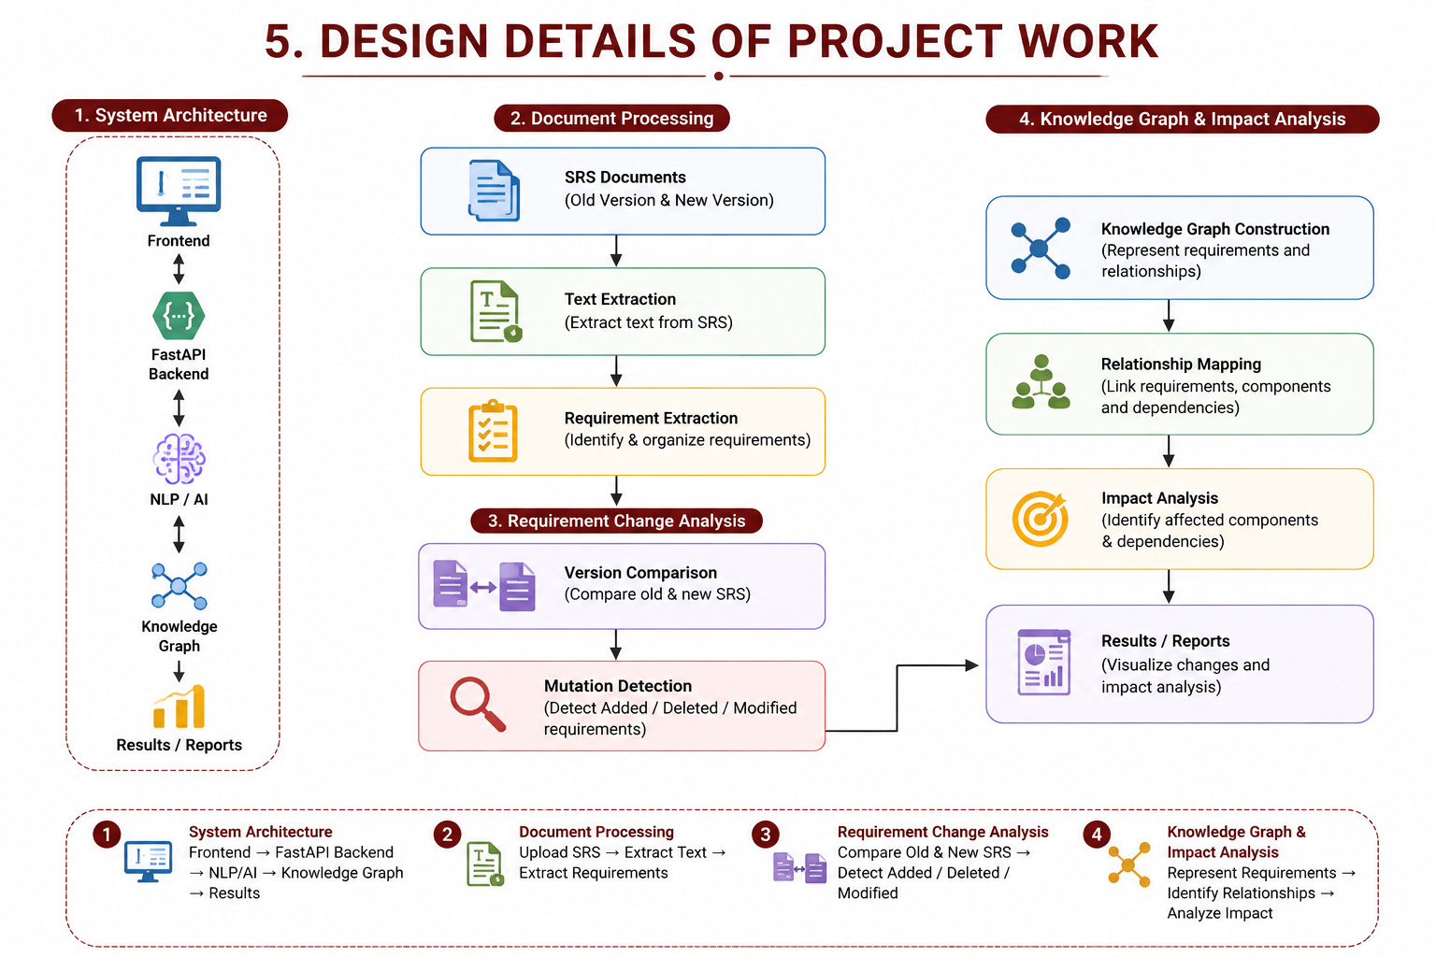
5.Design Details of Project Work
System Architecture
Frontend → FastAPI Backend → NLP/AI → Knowledge Graph → Results
Document Processing
Upload SRS → Extract text → Extract requirements
Requirement Change Analysis
Compare old & new SRS → Detect Added / Deleted / Modified req
Knowledge Graph & Impact Analysis
Represent Requirements → Identify Relationships → Analyze Impact
• SRS Document Processing
Extract and organize requirements from uploaded documents.
• Requirement Analysis
Identify and classify functional and non-functional requirements.
• Knowledge Graph Construction
Represent requirements and their relationships.
• Change & Impact Analysis
Detect added, deleted, and modified requirements and analyze their impact.

Slide 8
Thank you
VIKAS(4NI23CS243)
VIVEK B AKKI(4NI23CS250)
2023cs_vikas_d@nie.ac.in
2023cs_vivekbakki_d@nie.ac.in
“Understand the change. Trace the impact. Build with confidence.”

